Slide 1



Comment s’inscrire sur l’ODP
http://training.opendataforafrica.org

Slide 2
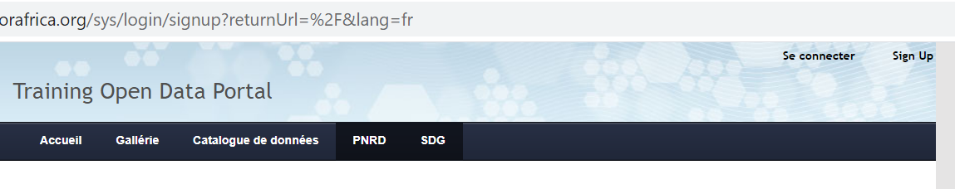
Accéder au site
Allez au site : https://training.opendataforafrica.org/
Cliquez sur « SignUp »

Slide 3
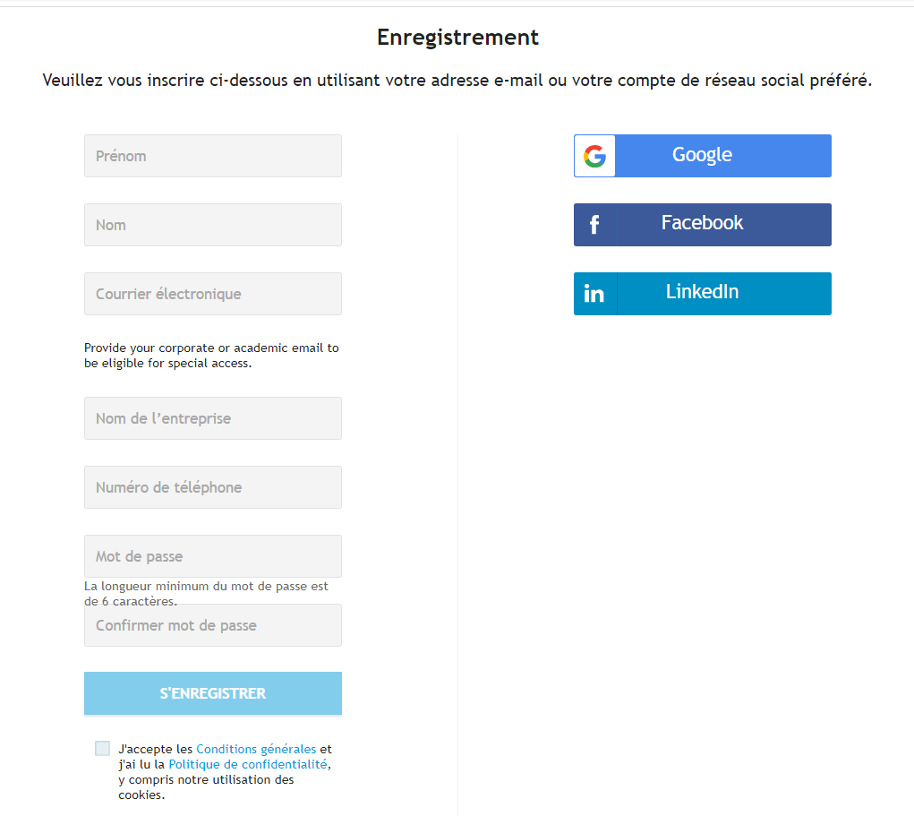

S’inscrire dans l’ODP
3. Remplir le formulaire
Notes:
Sign-up form like below will appear. You may need to enter all required details in the registration form. A valid email-id is required for the registration which can be an official email id/Gmail/Yahoo/Hotmail, etc

Slide 4
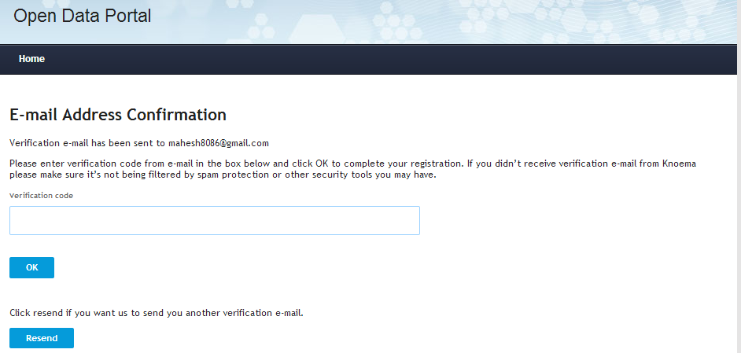
Email de vérification
4. Vous recevez un email de confirmation, cliquez sur le lien pour activer votre inscription
Notes:
After filling required details, Click Sign Up button to submit your details. Now, system will send a verification email to the registered email id along with security verification code and you will be re-directed to screen like this. You may copy and paste verification code received in email.

Slide 5
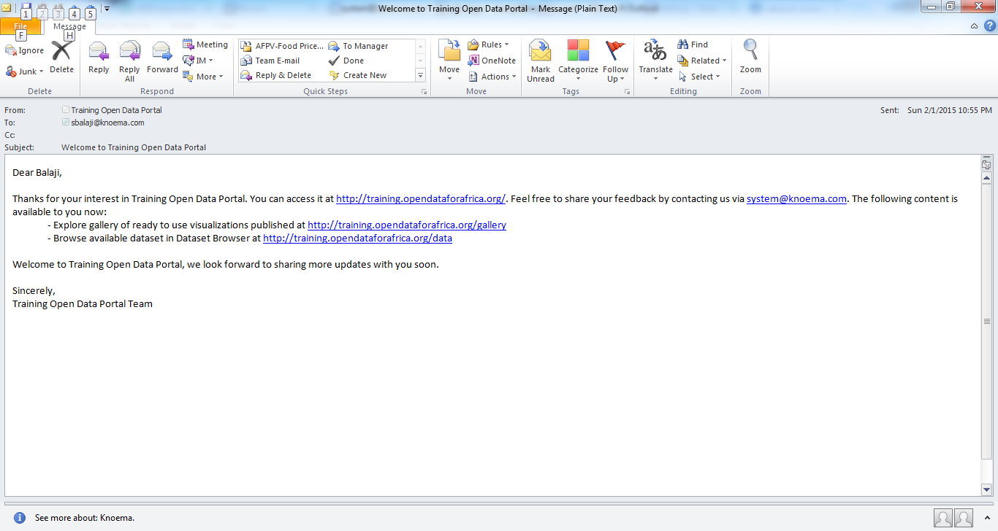
Email de bienvenu(e)
Notes:
If your email id verification is successful, you will be receiving a Welcome email like below.

Slide 6
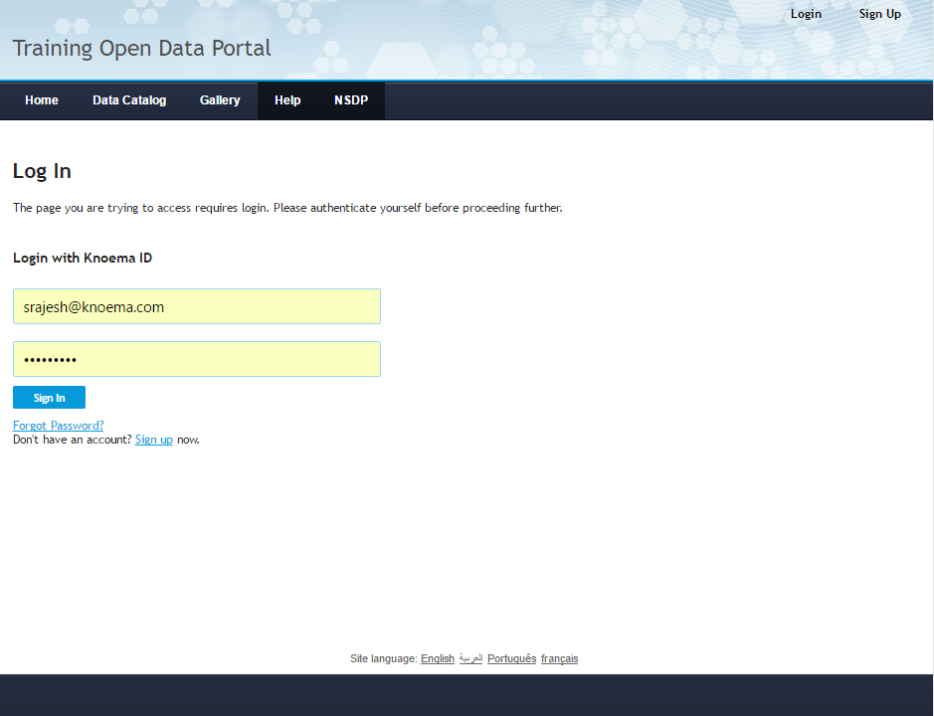
Page se connecter
Notes:
Once you receive welcome, you may proceed to Login with your account.

Slide 7
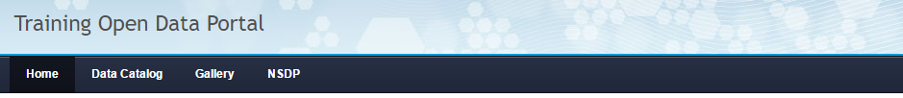
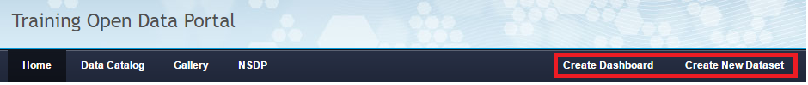
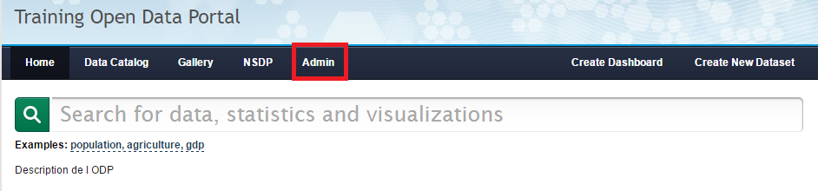
Page d’accueil après connexion
Visiteur
Contributeur / DataManager
Admin
Notes:
Click the upload data icon in main page to create a new dataset.

Slide 8


MERCI
aih@afdb.org

